Slide 1
E KYC FOR IMMIGRANTS By Auto Block A team where we empower each with autonomous power. As individual we function as a solid block. As a team, each block can be fit into any shapes in the blockchain
AUTO BLOCK

Slide 2
PROBLEM STATEMENT
Immigrants do not have proper personal identification documents
Immigrants are not able to receive welfares
food supply
Education for kids
Medical treatments
Employement
Government officials have a hard time tracking immigrants
Whereabouts
Total number of immigrants still in country

Slide 3
Number of immigrants in Malaysia in (in thousands)

Slide 4
OBJECTIVE
Create an E-KYC solutions for the immigrants.
Blockchain eliminates asymmetry flow of
Immigrants are not able to receive welfare like food supply
Government officials have a hard time tracking immigrants
Create employment opportunity for immigrants
Utilize available resources in various sectors

Slide 5
Two Content Layout with Table
Class | Group A | Group B
Class 1 | 82 | 95
Class 2 | 76 | 88
Class 3 | 84 | 90
First bullet point here
Second bullet point here
Third bullet point here

Slide 6
Two Content Layout with SmartArt
First bullet point here
Second bullet point here
Third bullet point here
Group A
Task 1
Group B
Task 1
Group C
Task 2
Task 2
Task 1
Task 2

Slide 7
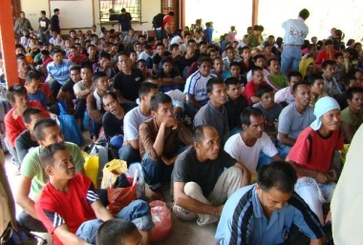

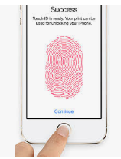

AuToken
B-Police
PDRM
(police)
B-Immigration
Immigration officer
Future
NGO
Future
NGO
Health Chain
Social Welfare
Future
Future
Insurance Company
Education Chain
Health Care
Future
Universal ID
Future
Catering
Education
Insurance
Private Sectors
Mall on Block

Slide 8
Platform
Permissioned Blockchain on Ethereum
Storage: IPFS
Hash algorithm: KECCAK-256
Token: AUTOKen

Slide 9
Future Expansion
Target: All citizens in Malaysia
Universal ID to access all government services
Authentication of
Car ownership
House ownership
Business ownership
EPF and beneficiary
University certificates
Education for all
Insurance
EPF disbursement
Banking

Slide 10
Add a Slide Title - 5

